Slide 1
Tasks
Successfully classify the digits and of the MNIST dataset using the MPS classifier, using encoding 1.
“ “ encoding 2.
Analyze the entanglement entropy of the classifier. Study the variation of the entanglement entropy and accuracy with the variation of the max bond dimension.
(Optional) Compress a classical NN weights using an MPO.

Slide 2
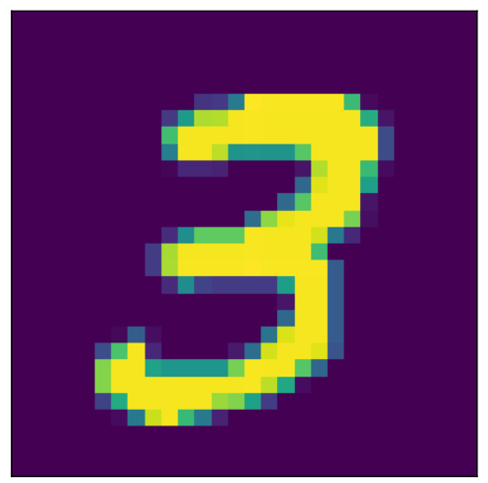
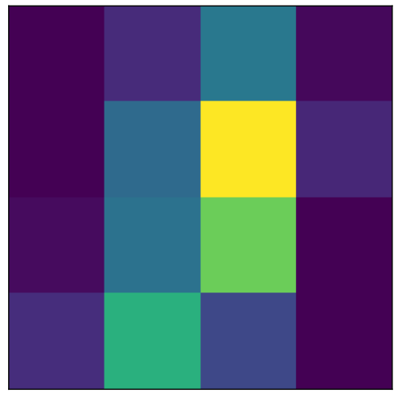
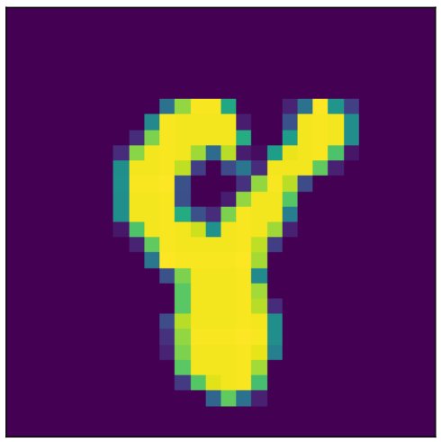

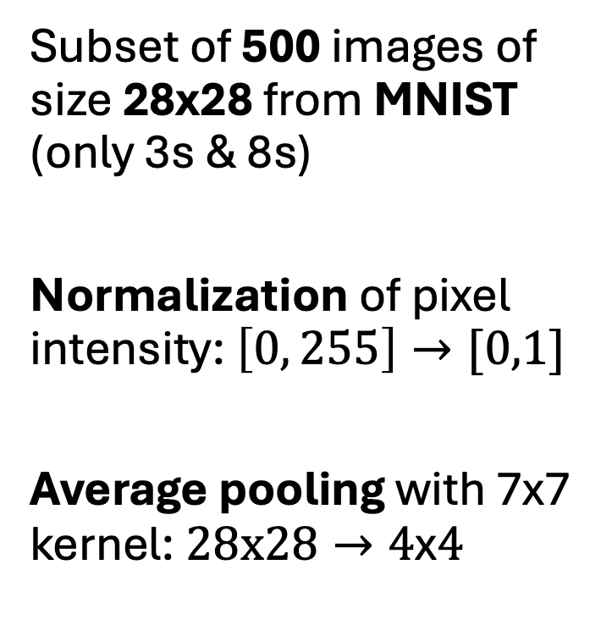
Data preparation
Subset of 500 images of size 28x28 from MNIST (only 3s & 8s)
Normalization of pixel intensity: $\left[0, 255\right]→[0,1]$
Average pooling with 7x7 kernel: $28x28→4\text{x}4$
AVG POOLING

Slide 3
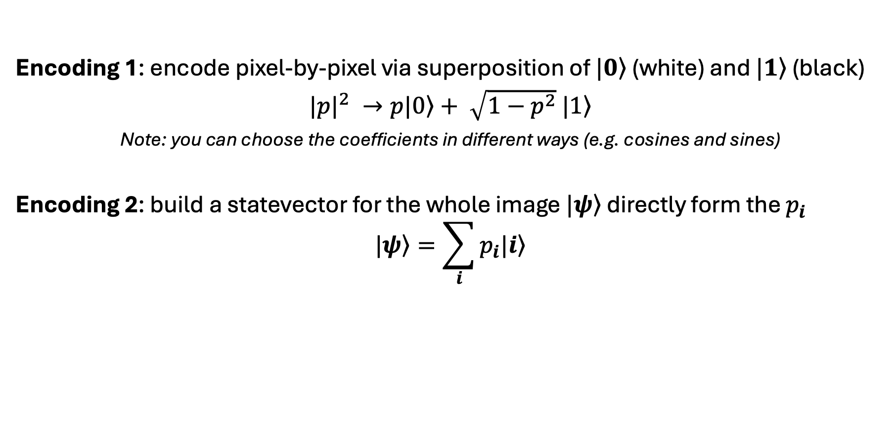
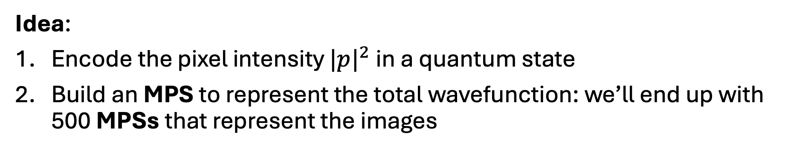
From images to quantum states
Idea:
Encode the pixel intensity ${|p|}^{2}$ in a quantum state
Build an MPS to represent the total wavefunction: we’ll end up with 500 MPSs that represent the images
Encoding 1: encode pixel-by-pixel via superposition of $\left.|0\right\rangle$ (white) and $\left.|1\right\rangle$ (black)
${|p|}^{2} →\left.p|0\right\rangle + \sqrt{1−p^{2}}$ $\left.|1\right\rangle$
Note: you can choose the coefficients in different ways (e.g. cosines and sines)
Encoding 2: build a statevector for the whole image $\left.|ψ\right\rangle$ directly form the $p_{i}$
$$\left.|ψ\right\rangle =\sum_{i}{p_{i}\left.|i\right\rangle }$$

Slide 4
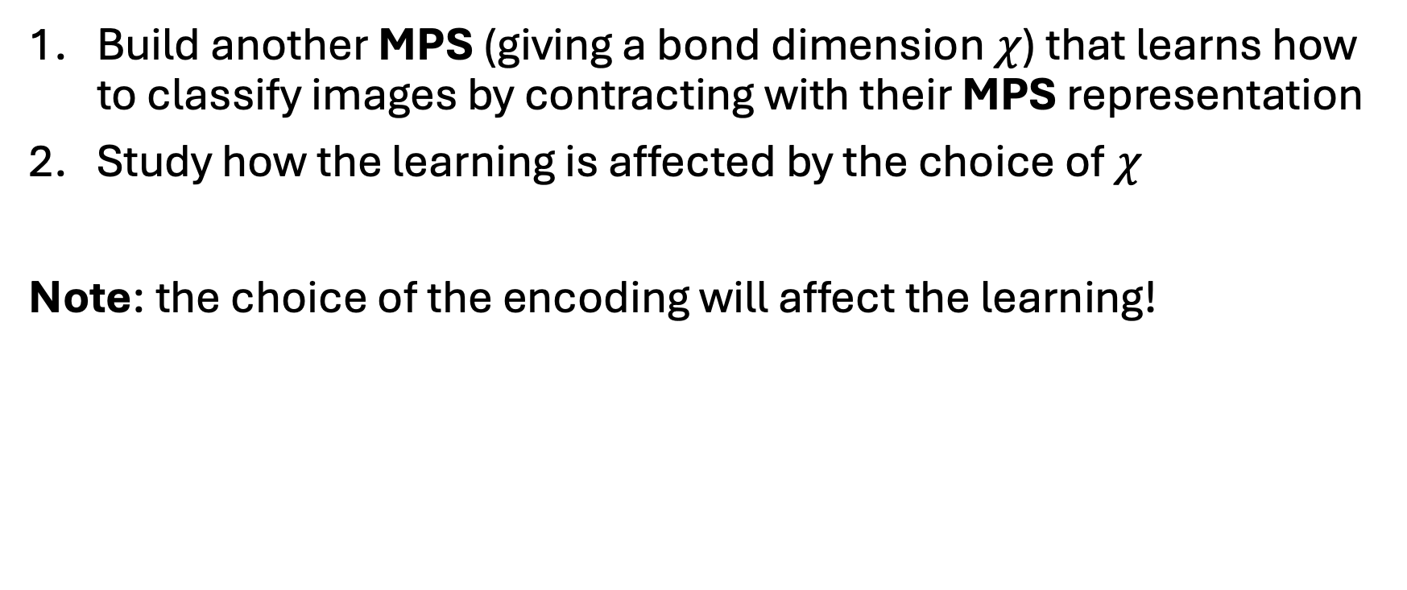
Learning process
Build another MPS (giving a bond dimension $χ$) that learns how to classify images by contracting with their MPS representation
Study how the learning is affected by the choice of $χ$
Note: the choice of the encoding will affect the learning!
Encoding 1 | Encoding 2
MPS classifier has 16 qubits | MPS classifier has 4 qubits

Slide 5
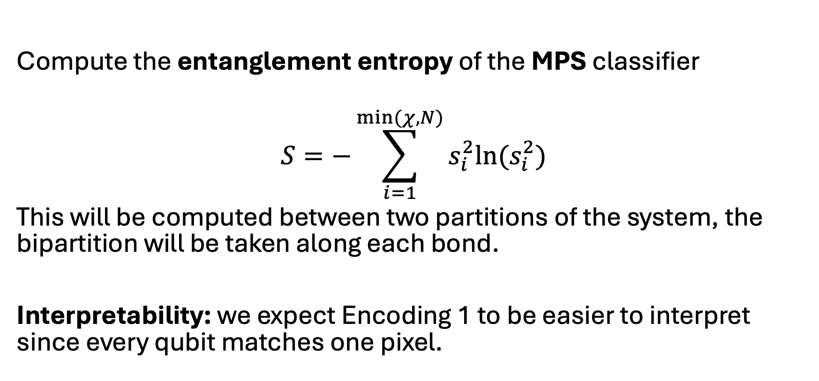
Analysis
Compute the entanglement entropy of the MPS classifier
$$S=−\sum_{i=1}^{min⁡(χ,N)}{s_{i}^{2}ln(s_{i}^{2})}$$
This will be computed between two partitions of the system, the bipartition will be taken along each bond.
Interpretability: we expect Encoding 1 to be easier to interpret since every qubit matches one pixel.

Slide 6
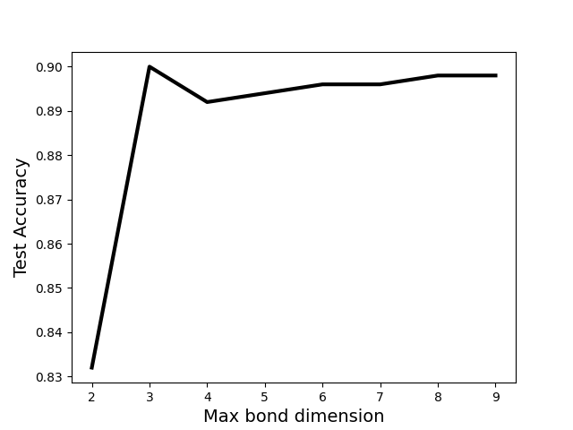
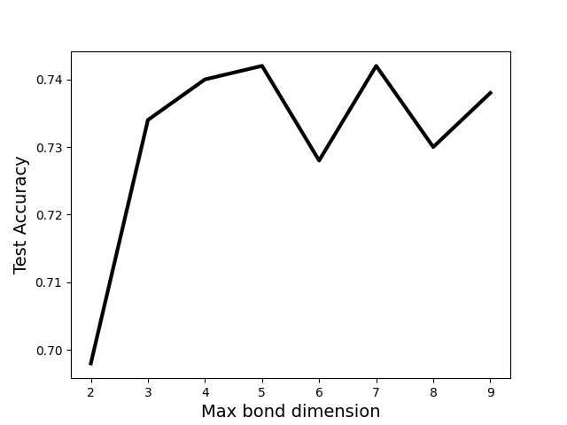
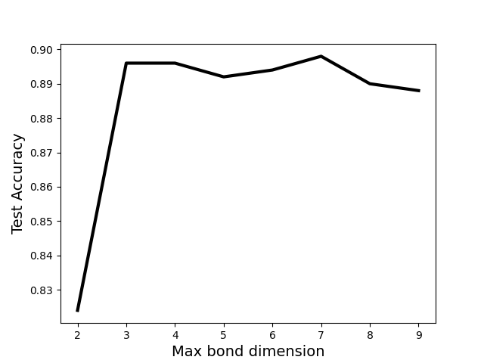
Test accuracy VS max bond dimension
Encoding 1.a
Encoding 2
Encoding 1.b

